Slide 1
Intro To Git

Slide 2
What is Git?
Git is a distributed version-control system for tracking changes in source code during software development. It is designed for coordinating work among programmers, but it can be used to track changes in any set of files. It is aimed at any scenario where multiple people are working on the same file(s) but is useful in other scenarios as well.
Git vs Git Hub
Git is the software used to manage version control. GitHub is essentially a cloud storage facility that is often used as the remote repository for projects using Git. Many projects big and small use Git but no Git Hub. In engineering we use Azure DevOps rather than GitHub.
Benefits
There are numerous benefits based on your use case. Personally they have included:
Easy peer review.
Quality Control
Disaster Recovery
Learning and Teaching

Slide 3
Git Interfaces
There are a number of different interfaces that allow you to interact with Git. Some examples include:
Bash
Power Shell
DevOps
Visual Studio
Most IDE’s offer some form of Git plugin.

Slide 4
Git Repository (repo)
The Git repository is the storage folder where files and the tracking data for changes to them are stored.
Repository's can be hosted in numerous places as well as be maintained on a single device.
In this course we will interact with a repository stored in Azure DevOps.

Slide 5
Git hands on
Heads up/basic instructions
We are now going to work step by step to see how git works in a practical manner:
1. Please avoid the urge to jump ahead, as tempting as it may be.
2. At various points I will ask if everyone is up to date before we move on. Please say if you are not, everyone moves at different speeds and we have plenty of time. Catching you up if you stay quiet and fall behind is far more disruptive than just waiting at a good point until everyone is ready.
3. On many slides I will give you the command and then an example underneath for if I was entering the command. Use both of these to make sure you are getting the correct syntax.
4. At the end you will have access to a cheat sheet and a copy of this PowerPoint so don’t worry about trying to take notes as well.

Slide 6
Navigate your context to Git training
Enter the command:
Open a file explorer window and navigate to where you saved your Git Training Repo. Open the repo folder, right click and select Git Bash here.

Slide 7
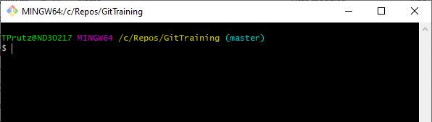
Git Window
You should have an open window much like this one. The two important parts are:
The writing in yellow which is the current context in which you are working, in this case the GitTraining repo.
The worder in brackets in light blue (master), this is the name of the branch you are currently working on.

Slide 8
List branches for the repo
Enter the command:
git branch -a

Slide 9
Create local branch in your name: git branch TomPrutz
Enter the command:
git branch <YourName>
E.g. git branch TomPrutz

Slide 10
List branches for repo: git branch
Enter the command:
git branch -a

Slide 11
Switch to new branch
Enter the command:
git checkout <BranchName>
E.g. git checkout TomPrutz

Slide 12
Look at the status of the branch
Enter the command:
git status
There is nothing being tracked on the branch.

Slide 13
Create text file in your name
Enter the command:
echo > <FileName>
E.g. echo > TomPrutz.txt

Slide 14
Status of Files and Git
Files have one of three status
Tracked - Tracked files are files that were in the last snapshot; they can be unmodified, modified, or staged. In short, tracked files are files that Git knows about.
Untracked - Any files in your working directory that were not in your last snapshot and are not in your staging area
Ignored – Files that you specifically want git not to include.
We aren’t going to cover ignored files in any detail here. There are lots of valid reasons for wanting files to be ignored.
You can create a “git ignore” file and anything listed in there will be ignored. At the point that you realise you want to ignore something Google is your friend.

Slide 15
Look at the status of the file
Enter the command:
git status
You will see something like:
Untracked files:
(use "git add <file>..." to include in what will be committed)
TomPrutz.txt

Slide 16
Add the text file to tracking
Enter the command:
git add <FileName>.txt
E.g. git add TomPrutz.txt

Slide 17
Look at status with file added
Enter the command:
git status

Slide 18
Commit the file: git commit -m "Added text file"
Enter the command:
git commit -m “<Enter useful commit message here>“
E.g. git commit -m "Added text file"

Slide 19
Open File Manager and find the find the text file.
Open a File Explorer Window
Navigate through the file structure until you can see the text file.

Slide 20
Check out master branch
Enter the command:
git checkout master
Now look back at the text file in file explorer, you should not be able to see it.

Slide 21
Check out named branch to see the text file return: git checkout TomPrutz
Enter the command:
git checkout <branchName>
E.g. git checkout TomPrutz

Slide 22
Go to the GitTraining Repo in DevOps
In your browser go to this link:
https://dev.azure.com/ordnancesurvey/common-engineering-training/_git/GitTraining

Slide 23
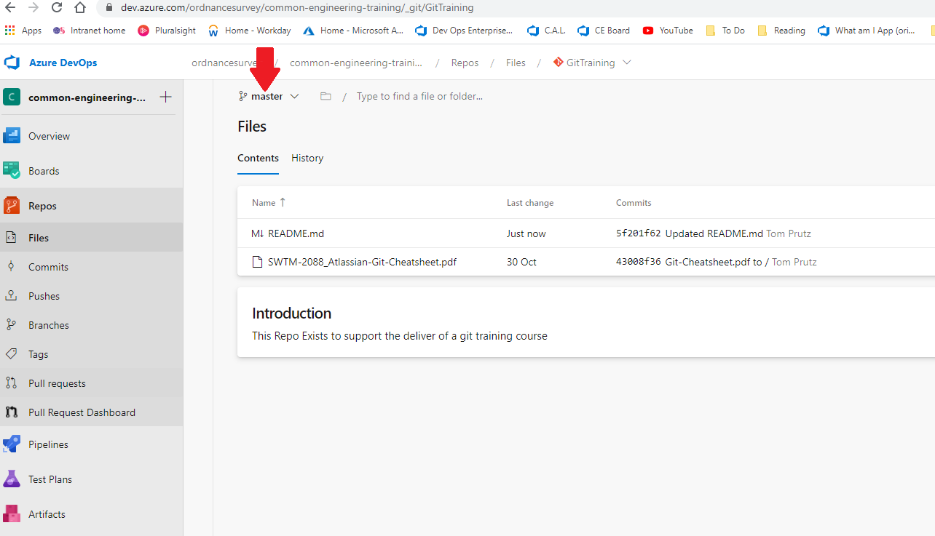
Look at branch dropdown.
Click on the drop down arrow by master.
You will see that there is only one branch.
You will also see your file isn’t here.
The remote and local work areas are entirely separate until you link them up. This means you can download someone else’s stuff and play with it without risking doing any permanent damage.

Slide 24
Connect branch to the remote origin and push it up
Enter the command:
git push --set-upstream origin <BranchName>
E.g. git push --set-upstream origin TomPrutz

Slide 25
View branches
Refresh your browser (not always necessary).
You will see an option to create a pull request. Press the X next to it so it disappears, we will do that later.
Now click the branch dropdown, you will see lots of branches, click on yours.
You should now see your text file in the repo.

Slide 26
Pull the contents of the repo down to your local machine.
Enter the command:
git pull

Slide 27
Look at the available branches
Enter the command:
git branch –a
You should now see a list of everyone's branches.

Slide 28
Checkout new branch
I am now going to put you into pairs.
This is important, please don’t try and jump ahead for this next bit.
Checkout your partners branch.
Enter the command:
git checkout <branch name>
E.g. git checkout TomPrutz

Slide 29
Edit the text file
Using the file explorer go to the repo.
Locate the text file and open it using a text editor e.g. notepad.
Add a single line of text which should be the first line of a story: e.g. Once upon a time….
Save the file and close it.

Slide 30
Check branch status
Enter the command:
git status
You will see the unstaged changes.

Slide 31
Add the changes to staging
Enter the command: don’t forget the space full stop at the end.
git add .
This adds all outstanding files.

Slide 32
Commit your changes
Enter the command:
git commit –m “<Helpful commit message>”
E.g. git commit -m "Added first line of a story"

Slide 33
Push your changes up to the remote repo
Enter the command:
git push
** We are going to wait until everyone is at the same point before carrying on **

Slide 34
Repeat the process
1.Check out your own branch: git checkout <branch name>
2. Pull it down: git pull
3. Add the second line of the story (underneath the first).
4. Add it to staging: git add .
5. Commit your changes with a useful message: git commit –m “<commit message>”
6. Push the changes up: git push
7. Wait for everyone to reach this point before moving on so you don’t get out of sync.
** We will repeat this process until each story has 4 lines but please wait at step 7 each time until I ask you to move on. If you don’t we can get out of sync and things get “complicated” **

Slide 35
Switch back to your original branch and look at the commits
Enter the command:
git log
You will now see a list of all the commits and for each one you will see:
The git hash(id)
The author,
The date/time they made the commit and
The commit message for each commit.
The letter q will help you leave the log if you are unable to enter a new command at the end of it.

Slide 36
Compare what you started with and what you have now.
Enter the command:
git diff <First 5 Chars of Commit guid for first commit> <First 5 Chars of Commit guid for last commit>
E.g. git diff a1b2c f4g5h

Slide 37
See the difference between branches
Enter the command:
git diff <your branch name> <your partners branch name>
E.g. git diff TomPrutz master
Remember you can use git log to see branches.

Slide 38
Azure DevOps
As we can see this is not a great way of reviewing changes. Azure DevOps provides a much better interface for the same thing.
Follow this link back to the repo:
https://dev.azure.com/ordnancesurvey/common-engineering-training/_git/GitTraining
Then on the left click on pull request.

Slide 39
Create a pull request
Click the new pull request button in the upper right portion of the screen.
On the next screen under the heading New pull request there are two branch drop downs.
Select the first one as your branch and the second one as master.
Add a title and description.
Under reviewers add your partner.
Create the pull request.

Slide 40
Review the pull request assigned to you.
Click pull requests on the left.
You will see the pull request you created under mine and you may see a second one assigned to you. If not go to active and look down the list to find the one assigned to you.
Click on the pull request and take a look at it:
Overview gives you an idea of what processes have been completed, who is assigned to it etc...
Files shows you the various files and folders that differ between the two branches.
Updates will show you any changes since the PR was created.
Commits shows you all the commits that make up the PR.
Files is useful because you can review changes and leave comments/feedback/suggestions.
Leave a comment (it doesn’t matter what the actual comment is) on one of the files, then click approve on the overview screen.

Slide 41
Review your own pull request
Go to pull requests again, click on mine and open the pull request you created.
Find the comment and review it.
Click resolve and then click complete.
In many cases completing a PR will trigger a pipeline to update/deploy an application.

Slide 42
Pull down master
Once everyone has completed their pull requests we will update our local repo to bring it in line with the remote.
In Git Bash switch to master and pull down.
Now go to the repo in file explorer and you should see everyone's file.
You now have a full up to date copy of everything you have done.
Now delete the entire git training repo folder. If you have a recycle bin empty the contents from there.

Slide 43
Disaster
It turns out you needed some of those things you just deleted.
No problem. Return to DevOps, get the link to clone and clone the repo down (git clone <link>) to you repo’s folder. You now have everything available again.
This is a reminder that until you push up nothing you have done locally effects the remote and until you pull down nothing changed in the remote changes locally.
It is good practice not to push directly to master. Instead push on your own branch, create a pull request, have it reviewed and then merge it in. This helps protect master as the working up to date branch.
There are settings that can be used to prevent pushing directly to master.
You can also revert to specific commits. If you end up messing up a document, deleting things by accident or just generally break things you can revert everything back to the state it was in at any commit. This makes regularly commits with useful messages very good practice.

Slide 44
All done – any questions?
Don’t forget there is the cheat sheet in the repo.

